Slide 1
Discriminant Analysis
Prepared by : Sunil Naidu G R

Slide 2
Discriminant Analysis
Discriminant analysis is the earliest statistical classifier; it was introduced by R. A. Fisher in 1936 in an article published in the Annals of Eugenics journal.2 While discriminant analysis encompasses several techniques, the most commonly used is linear discriminant analysis, or LDA. The original method proposed by Fisher was actually slightly different from LDA, but the mechanics are essentially the same.
LDA is now less widely used with the advent of more sophisticated techniques, such
as tree models and logistic regression.
Key Terms for Discriminant Analysis
Covariance
A measure of the extent to which one variable varies in concert with another (i.e., similar magnitude and direction).
Discriminant function
The function that, when applied to the predictor variables, maximizes the separation of the classes.
Discriminant weights
The scores that result from the application of the discriminant function and are used to estimate probabilities of belonging to one class or another.

Slide 3
Covariance Matrix
To understand discriminant analysis, it is first necessary to introduce the concept ofc covariance between two or more variables. The covariance measures the relationship between two variables x and z. Denote the mean for each variable by x and z. The covariance sx, z between x and z is given by:
Cov(X,Y)=1/n−1 ∑i=1 n​ (Xi​−Xˉ)(Yi​−Yˉ)​
where n is the number of records (note that we divide by n – 1 instead of n;

Slide 4
Fisher’s Linear Discriminant
For simplicity, let’s focus on a classification problem in which we want to predict a binary outcome y using just two continuous numeric variables x, z . Technically, discriminant analysis assumes the predictor variables are normally distributed continuous variables, but, in practice, the method works well even for nonextreme departures from normality, and for binary predictors. Fisher’s linear discriminant distinguishes variation between groups, on the one hand, from variation within groups on the other. Specifically, seeking to divide the records into two groups, linear discriminant analysis (LDA) focuses on maximizing the “between” sum of squares SSbetween (measuring the variation between the two groups) relative to the “within” sum of squares SSwithin (measuring the within-group variation). In this case, the two groups correspond
to the records x0, z0 for which y = 0 and the records x1, z1 for which y = 1.
The method finds the linear combination wxx + wzz that maximizes that sum of
squares ratio:
Ssbetween/Sswithin
The between sum of squares is the squared distance between the two group means, and the within sum of squares is the spread around the means within each group, weighted by the covariance matrix. Intuitively, by maximizing the between sum of squares and minimizing the within sum of squares, this method yields the greatest separation between the two groups.

Slide 5
A Simple Example
The MASS package, associated with the book Modern Applied Statistics with S by W. N. Venables and B. D. Ripley (Springer, 1994), provides a function for LDA with R. The following applies this function to a sample of loan data using two predictor variables, borrower_score and payment_inc_ratio, and prints out the estimated linear discriminator
weights:
In Python, we can use Linear Discriminant Analysis from sklearn. discriminant_analysis. The scalings_ property gives the estimated weights:
loan3000.outcome = loan3000.outcome.astype('category')
predictors = ['borrower_score', 'payment_inc_ratio']
outcome = 'outcome'
X = loan3000[predictors]
y = loan3000[outcome]
loan_lda = LinearDiscriminantAnalysis()
loan_lda.fit(X, y)
pd.DataFrame(loan_lda.scalings_, index=X.columns)

Slide 6
A plot of the predictions helps illustrate how LDA works. Using the output from the predict function, a plot of the estimated probability of default is produced as follows:
A similar graph is created in Python using this code:
# Use scalings and center of means to determine decision boundary
center = np.mean(loan_lda.means_, axis=0)
slope = - loan_lda.scalings_[0] / loan_lda.scalings_[1]
intercept = center[1] - center[0] * slope
# payment_inc_ratio for borrower_score of 0 and 20
x_0 = (0 - intercept) / slope
x_20 = (20 - intercept) / slope
lda_df = pd.concat([loan3000, pred['default']], axis=1)
lda_df.head()
fig, ax = plt.subplots(figsize=(4, 4))
g = sns.scatterplot(x='borrower_score', y='payment_inc_ratio',
hue='default', data=lda_df,
palette=sns.diverging_palette(240, 10, n=9, as_cmap=True),
ax=ax, legend=False)
ax.set_ylim(0, 20)
ax.set_xlim(0.15, 0.8)
ax.plot((x_0, x_20), (0, 20), linewidth=3)
ax.plot(*loan_lda.means_.transpose())

Slide 7
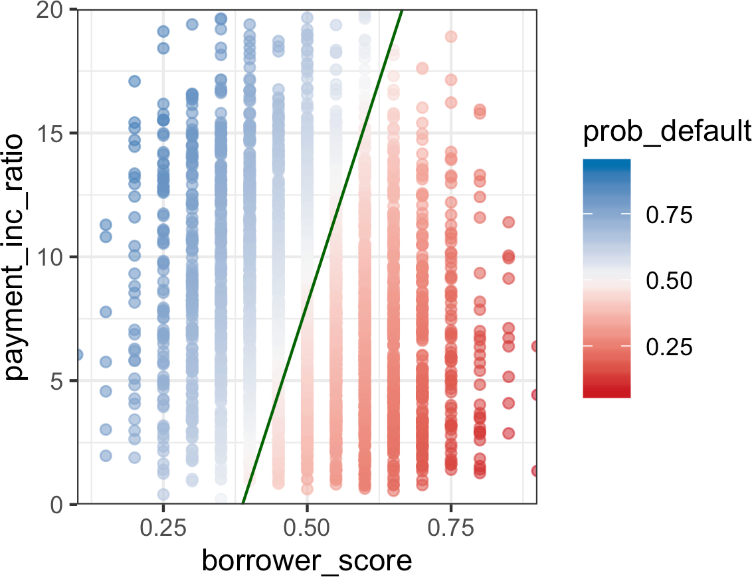
The resulting plot is shown in Figure 5-1. Data points on the left of the diagonal line
are predicted to default (probability greater than 0.5).
Using the discriminant function weights, LDA splits the predictor space into two regions, as shown by the solid line. The predictions farther away from the line in both
directions have a higher level of confidence (i.e., a probability further away from 0.5).
Figure 5-1. LDA prediction of loan default using two variables: a score of the borrower’s creditworthiness and the payment-to-income ratio

Slide 8
Generalized Linear Models
Generalized linear models (GLMs) are characterized by two main components:
• A probability distribution or family (binomial in the case of logistic regression)
• A link function—i.e., a transformation function that maps the response to the predictors (logit in the case of logistic regression)
Logistic regression is by far the most common form of GLM. A data scientist will encounter other types of GLMs. Sometimes a log link function is used instead of the logit; in practice, use of a log link is unlikely to lead to very different results for most applications. The Poisson distribution is commonly used to model count data (e.g., the number of times a user visits a web page in a certain amount of time). Other families include negative binomial and gamma, often used to model elapsed time (e.g., time to failure). In contrast to logistic regression, application of GLMs with these models is more nuanced and involves greater care. These are best avoided unless you are familiar with and understand the utility and pitfalls of these methods.
Predicted Values from Logistic Regression The predicted value from logistic regression is in terms of the log odds:
Y = log Odds Y = 1 . The predicted probability is given by the logistic response
function:
p = 1/(1 + e−Y)

Slide 9
For example, look at the predictions from the model logistic_model
In Python, we can convert the probabilities into a data frame and use the describe method to get these characteristics of the distribution:
pred = pd.DataFrame(logit_reg.predict_log_proba(X),
columns=loan_data[outcome].cat.categories)
pred.describe()
Converting these values to probabilities is a simple transform:
prob <- 1/(1 + exp(-pred))
> summary(prob)
Min. 1st Qu. Median Mean 3rd Qu. Max.
0.06269 0.37313 0.49787 0.50000 0.62365 0.97096

Slide 10
Interpreting the Coefficients and Odds Ratios
One advantage of logistic regression is that it produces a model that can be scored to new data rapidly, without recomputation. Another is the relative ease of interpretation of the model, as compared with other classification methods. The key conceptual idea is understanding an odds ratio. The odds ratio is easiest to understand for a binary factor variable X:
odds ratio = Odds Y = 1 X = 1
Odds Y = 1 X = 0
This is interpreted as the odds that Y = 1 when X = 1 versus the odds that Y = 1 when X = 0. If the odds ratio is 2, then the odds that Y = 1 are two times higher when X = 1
versus when X = 0.
Why bother with an odds ratio rather than probabilities? We work with odds because
the coefficient βj in the logistic regression is the log of the odds ratio for Xj.
Example For the model fit in “Logistic Regression and the GLM” of the regression coefficient for purpose_small_business is 1.21526. This means that a loan to a small business compared to a loan to pay off credit card debt reduces the odds of defaulting versus being paid off by exp 1.21526 ≈ 3.4. Clearly, loans for the purpose of creating or expanding a small business are considerably riskier than other types of loans. Figure 5-3 shows the relationship between the odds ratio and the log-odds ratio for
odds ratios greater than 1. Because the coefficients are on the log scale, an increase of
1 in the coefficient results in an increase of exp 1 ≈ 2.72 in the odds ratio.

Slide 11
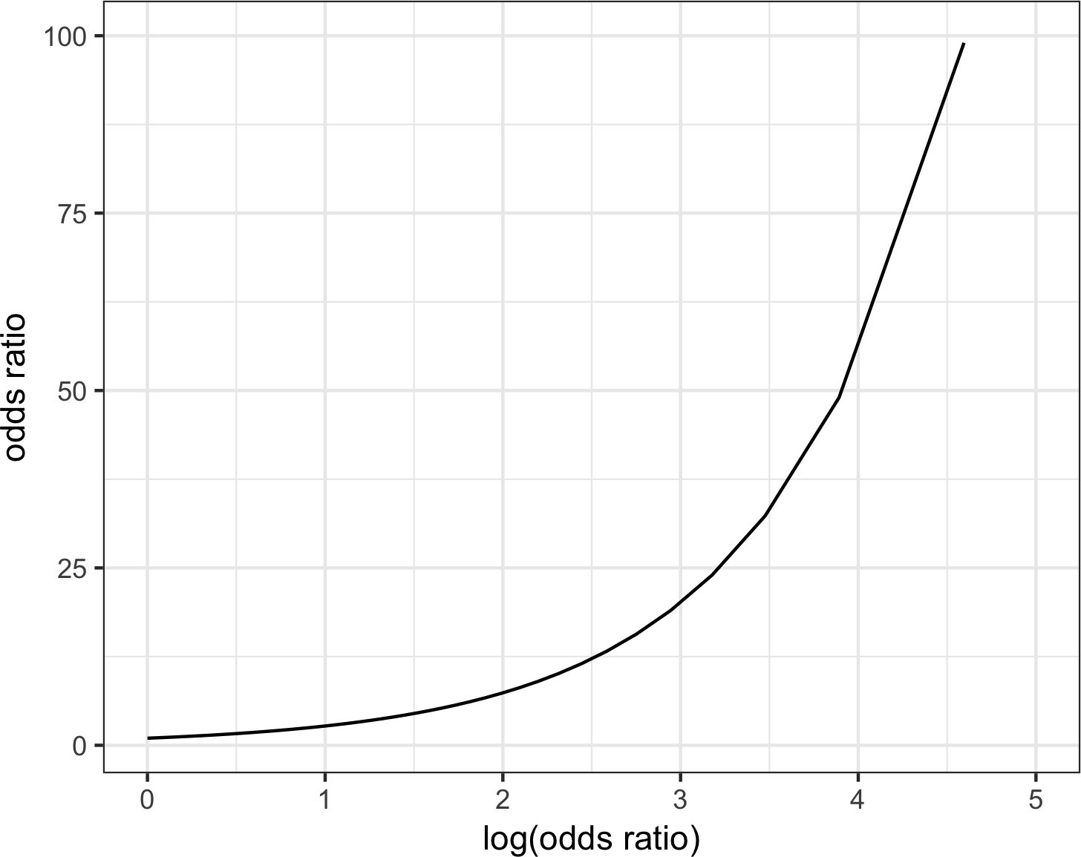
Odds ratios for numeric variables X can be interpreted similarly: they measure the
change in the odds ratio for a unit change in X. For example, the effect of increasing
the payment-to-income ratio from, say, 5 to 6 increases the odds of the loan defaulting by a factor of exp 0.08244 ≈ 1.09. The variable borrower_score is a score on the borrowers’ creditworthiness and ranges from 0 (low) to 1 (high). The odds of the best borrowers relative to the worst borrowers defaulting on their loans is smaller by a factor of exp − 4.61264 ≈ 0.01. In other words, the default risk from the borrowers with the poorest credit worthiness is 100 times greater than that of the best borrowers!
Figure 5-3. The relationship between the odds ratio and the log-odds ratio

Slide 12
Strategies for Imbalanced Data
The previous section dealt with evaluation of classification models using metrics that go beyond simple accuracy and are suitable for imbalanced data—data in which the outcome of interest (purchase on a website, insurance fraud, etc.) is rare. In this section, we look at additional strategies that can improve predictive modeling performance with imbalanced data.
Key Terms for Imbalanced Data
Undersample
Use fewer of the prevalent class records in the classification model.
Synonym
Downsample
Oversample
Use more of the rare class records in the classification model, bootstrapping if necessary.
Synonym
Upsample
Up weight or down weight
Attach more (or less) weight to the rare (or prevalent) class in the model.
Data generation
Like bootstrapping, except each new bootstrapped record is slightly different from its source.
z-score
The value that results after standardization.
K
The number of neighbors considered in the nearest neighbor calculation

Slide 13
Undersampling
If you have enough data, as is the case with the loan data, one solution is to undersample
(or downsample) the prevalent class, so the data to be modeled is more balanced between 0s and 1s. The basic idea in undersampling is that the data for the dominant class has many redundant records. Dealing with a smaller, more balanced data set yields benefits in model performance, and it makes it easier to prepare the data and to explore and pilot models.
How much data is enough? It depends on the application, but in general, having tens of thousands of records for the less dominant class is enough. The more easily distinguishable the 1s are from the 0s, the less data needed.
The loan data analyzed in “Logistic Regression” on page 208 was based on a balanced training set: half of the loans were paid off, and the other half were in default. The predicted values were similar: half of the probabilities were less than 0.5, and half were greater than 0.5. In the full data set, only about 19% of the loans were in default in Python:
predictors = ['payment_inc_ratio', 'purpose_', 'home_', 'emp_len_',
'dti', 'revol_bal', 'revol_util']
outcome = 'outcome'
X = pd.get_dummies(full_train_set[predictors], prefix='', prefix_sep='',
drop_first=True)
y = full_train_set[outcome]
full_model = LogisticRegression(penalty='l2', C=1e42, solver='liblinear')
full_model.fit(X, y)
print('percentage of loans predicted to default: ',
100 * np.mean(full_model.predict(X) == 'default'))

Slide 14
Only 0.39% of the loans are predicted to be in default, or less than 1/47 of the expected number.5 The loans that were paid off overwhelm the loans in default because the model is trained using all the data equally. Thinking about it intuitively, the presence of so many nondefaulting loans, coupled with the inevitable variability in predictor data, means that, even for a defaulting loan, the model is likely to find some non defaulting loans that it is similar to, by chance. When a balanced sample was used, roughly 50% of the loans were predicted to be in default.
Oversampling and Up/Down Weighting
One criticism of the undersampling method is that it throws away data and is not using all the information at hand. If you have a relatively small data set, and the rarer class contains a few hundred or a few thousand records, then undersampling the dominant class has the risk of throwing out useful information. In this case, instead of downsampling the dominant case, you should oversample (upsample) the rarer class by drawing additional rows with replacement (bootstrapping).
Most scikit-learn methods allow specifying weights in the fit function using the
keyword argument sample_weight:
default_wt = 1 / np.mean(full_train_set.outcome == 'default')
wt = [default_wt if outcome == 'default' else 1
for outcome in full_train_set.outcome]
full_model = LogisticRegression(penalty="l2", C=1e42, solver='liblinear')
full_model.fit(X, y, sample_weight=wt)
print('percentage of loans predicted to default (weighting): ',
100 * np.mean(full_model.predict(X) == 'default'))

